Slide 1
चरैवेति, चरैवेति
Keep progressing to attain a higher self.
avinash.bhagat@lpu.co.in Dr. Avinash Bhagat 9463281930

Slide 2
CAP256: Computer Networks
Lecture 21-23
IP addresses
avinash.bhagat@lpu.co.in Avinash Bhagat 9463281930

Slide 3
IP Addresses: Classful Addressing
Objectives
Understand IPv4 addresses
Class full addresses
Subnet mask and its purpose
Class less inter domain routing.
Sub netting and Super netting.
Understand NAT

Slide 4

Note:
An IP address is a 32-bit address.
The IP addresses are unique.
The address space of IPv4 is
2³² or 4,294,967,296.

Slide 5
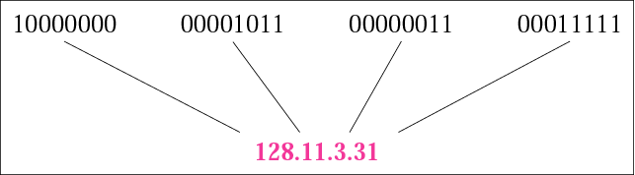

Dotted-decimal notation

Slide 6
Example 1
Change the following IP addresses from binary notation to dotted-decimal notation.
a. 10000001 00001011 00001011 11101111
b. 11000001 10000011 00011011 11111111
c. 11100111 11011011 10001011 01101111
d. 11111001 10011011 11111011 00001111
Answer
Solution
a. 129.11.11.239
b.193.131.27.255
c. 231.219.139.111
d. 249.155.251.15

Slide 7
Example 2
Change the following IP addresses from dotted-decimal notation to binary notation.
a. 111.56.45.78 b. 221.34.7.82
c. 241.8.56.12 d. 75.45.34.78
Solution
Answer
We replace each decimal number with its binary equivalent:
a. 01101111 00111000 00101101 01001110
b. 11011101 00100010 00000111 01010010
c. 11110001 00001000 00111000 00001100
d. 01001011 00101101 00100010 01001110

Slide 8
Example 3
Find the error, if any, in the following IP addresses:
a. 111.56.045.78 b. 221.34.7.8.20
c. 75.45.301.14 d. 11100010.23.14.67
Solution
Answers
a. There are no leading zeroes in dotted-decimal notation (045).
b. We may not have more than four numbers in an IP address.
c. In dotted-decimal notation, each number is less than or equal
to 255; 301 is outside this range.
d. A mixture of binary notation and dotted-decimal notation is not
allowed. Or if considered only decimal then first octet is out of range(0-255)

Slide 9
Example 4
Change the following IP addresses from binary notation to hexadecimal notation.
a. 10000001 00001011 00001011 11101111
b. 11000001 10000011 00011011 11111111
Solution
We replace each group of 4 bits with its hexadecimal equivalent (see Appendix B). Note that hexadecimal notation normally has no added spaces or dots; however, 0X (or 0x) is added at the beginning or the subscript 16 at the end to show that the number is in hexadecimal.
a. 0X810B0BEF or 810B0BEF₁₆
b. 0XC1831BFF or C1831BFF₁₆
Ans

Slide 10
CLASSFUL ADDRESSING
IP addresses, when started , used the concept of classes.
This architecture is called classful addressing.
In the mid-1990s, a new architecture, called classless addressing, was introduced and will eventually supersede the original architecture.
However, part of the Internet is still using classful addressing, but the migration is very fast.

Slide 11
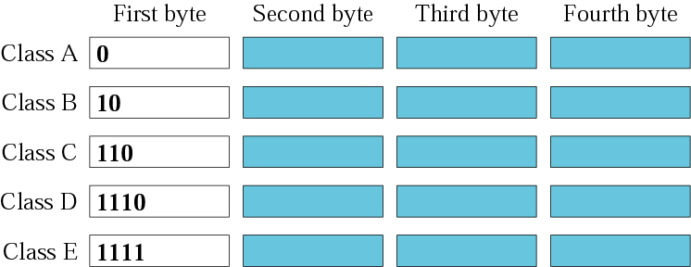

Finding the class in binary notation

Slide 12
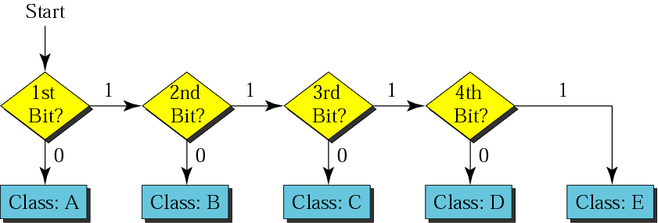
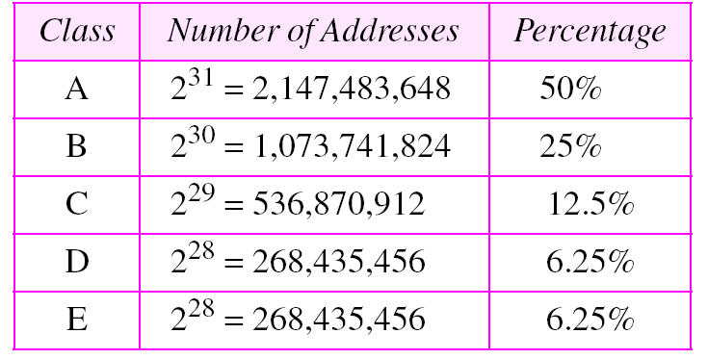
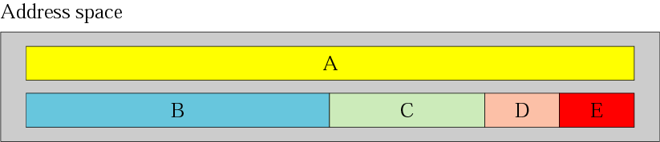
CLASSFUL ADDRESSING

Slide 13
Example 6
Find the class of each address:
a. 00000001 00001011 00001011 11101111
b. 11000001 10000011 00011011 11111111
c. 10100111 11011011 10001011 01101111
d. 11110011 10011011 11111011 00001111
Answers
Solution
a. The first bit is 0. This is a class A address.
b. The first 2 bits are 1; the third bit is 0. This is a class C address.
c. The first bit is 0; the second bit is 1. This is a class B address.
d. The first 4 bits are 1s. This is a class E address.

Slide 14
Example 7
Find the class of each address:
a. 227.12.14.87 b.193.14.56.22 c.14.23.120.8
d. 252.5.15.111 e.134.11.78.56
Answers
Solution
a. The first byte is 227 (between 224 and 239); the class is D.
b. The first byte is 193 (between 192 and 223); the class is C.
c. The first byte is 14 (between 0 and 127); the class is A.
d. The first byte is 252 (between 240 and 255); the class is E.
e. The first byte is 134 (between 128 and 191); the class is B.

Slide 15
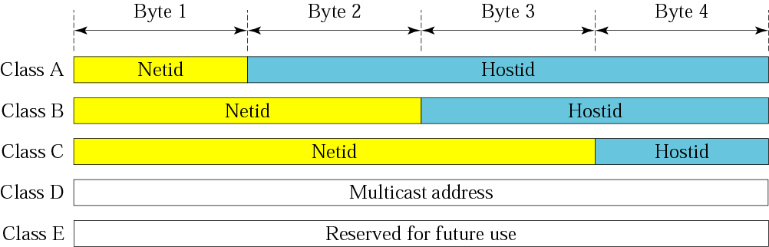
Netid and hostid

Slide 16
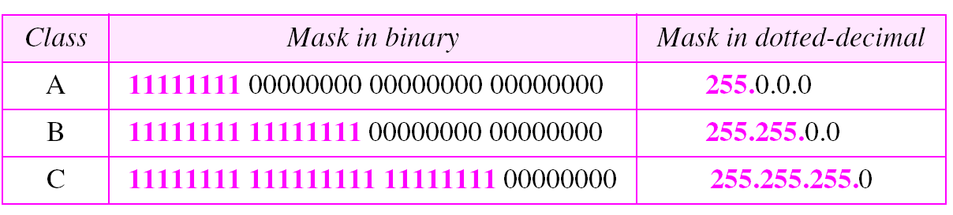
Note:

Slide 17
Note:
In classful addressing,
the network address (the first address in the block) is the one that is assigned to the organization.
The broadcast address (the last address in the block) .

Slide 18
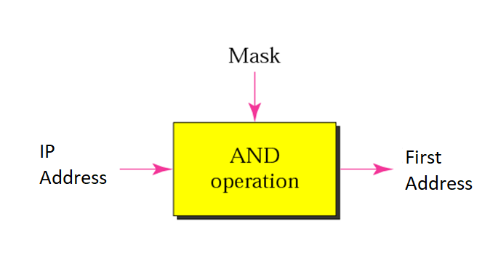
Calculating First or Network address

Slide 19
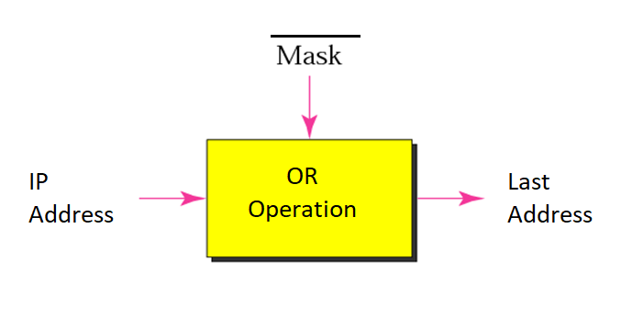
Calculating Last or Broadcast address

Slide 20
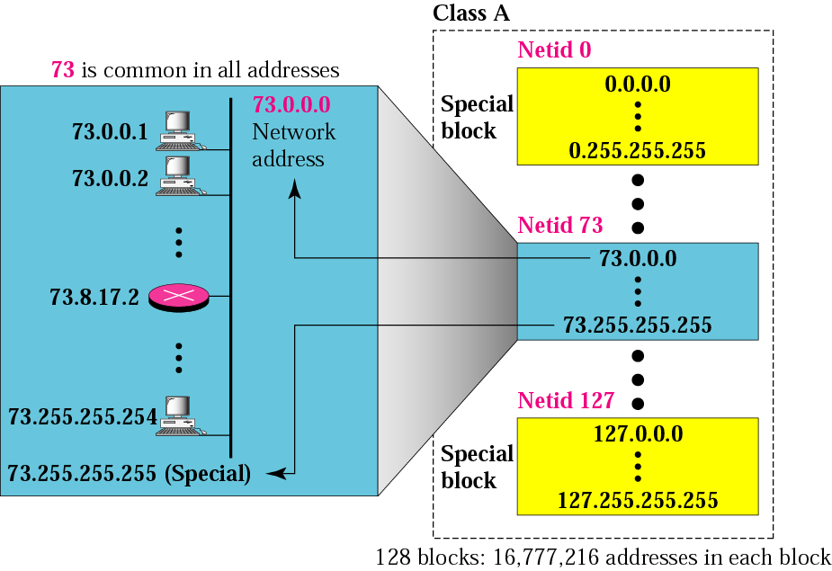
Blocks in class A

Slide 21
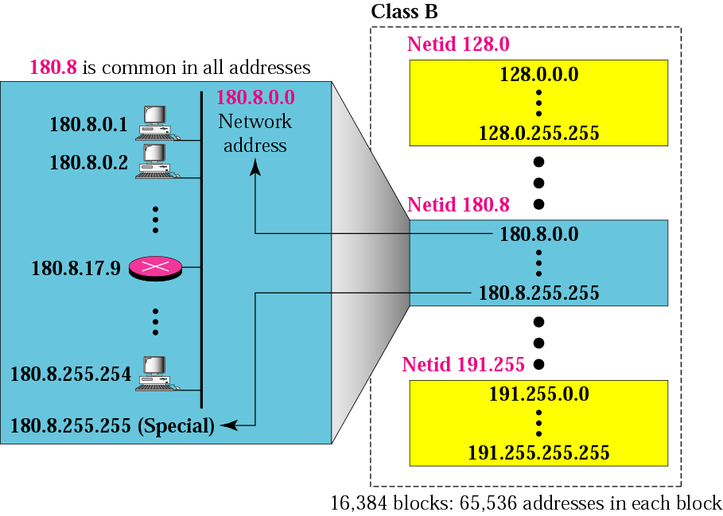
Blocks in class B

Slide 22

Blocks in class C

Slide 23
Example
Given the network address 17.0.0.0, find the class, the block, and the range of the addresses.
Solution
The class is A because the first byte is between 0 and 127.
The block has a netid of 17.0.0.0
Broadcast address is 17.255.255.255
The addresses range from 17.0.0.0 to 17.255.255.255.

Slide 24
Example
Given the network address 132.21.0.0, find the class, the block, and the range of the addresses.
Solution
The class is B because the first byte is between 128 and 191. The block has a netid of 132.21.0.0
Broadcast address is 132.21.255.255
The addresses range from 132.21.0.0 to 132.21.255.255.
TCP/IP Protocol Suite

Slide 25
Example
Given the network address 220.34.76.0, find the class, the block, and the range of the addresses.
Solution
The class is C because the first byte is between 192 and 223. The block has a netid of 220.34.76.0
Broadcast address is 220.34.76.255
The addresses range from 220.34.76.0 to 220.34.76.255.
TCP/IP Protocol Suite

Slide 26
Example
Given the address 23.56.7.91, find the beginning address (network address).
Solution
The default mask is 255.0.0.0, which means that only the first byte is preserved and the other 3 bytes are set to 0s.
The network address is 23.0.0.0
The broadcast address is 23.255.255.255

Slide 27
Example
Given the address 132.6.17.85, find the beginning address (network address).
Solution
The default mask is 255.255.0.0, which means that the first 2 bytes are preserved and the other 2 bytes are set to 0s.
The network address is 132.6.0.0.
The broadcast addressis 132.6.255.255

Slide 28
Example
Given the address 201.180.56.5, find the beginning address (network address).
Solution
The default mask is 255.255.255.0, which means that the first 3 bytes are preserved and the last byte is set to 0. The network address is 201.180.56.0.
TCP/IP Protocol Suite

Slide 29
Note:
1st flaw in this design
A block in class A address is too large for almost any organization.
This means most of the addresses in class A were wasted and were not used

Slide 30
Note:
2nd flaw in this design
A block in class B is also very large, probably too large for many of the organizations that received a class B block

Slide 31
Note:
3rd flaw in this design
A block in class C is probably too small for many organizations

Slide 32
Note:
4th flaw in this design
Class D addresses are used for multicasting; there is only one block in this class.
5th flaw in this design
Class E addresses are reserved for future purposes; most of the block is wasted.

Slide 33
Solution
Subnetting and Supernetting
CIDR Classless Interdomain Routing
NAT Network Address Translation
IP Version 6

Slide 34
SUBNETTING AND SUPERNETTING
Note:
Subnetting means dividing a network in multiple small networks.
We use subnetting mainly to save the wastage of IP addresses.
In classful addressing, There are two types of subnetting,
FLSM (Fixed Length Subnet Mask)
VLSM (Variable Length Subnet Mask).

Slide 35
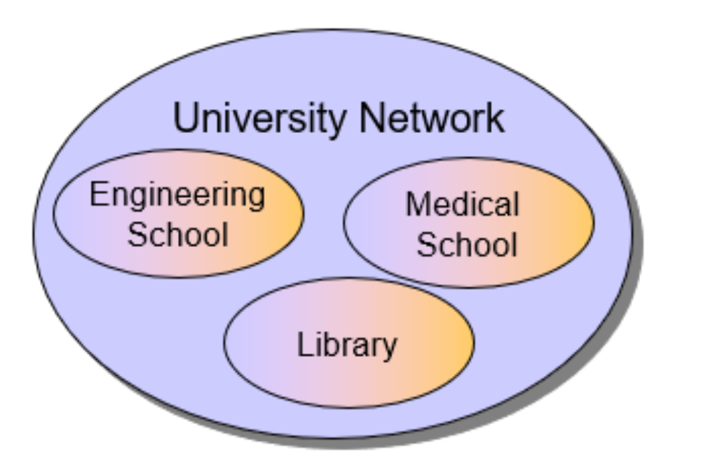
SUBNETTING Example FLSM

Slide 36
SUBNETTING Example FLSM
Let’s, consider an IP address 198.168.10.0
  Divide this IP address into 4 subnetwork parts.
  After dividing find out the range of IP addresses blocks.

Slide 38
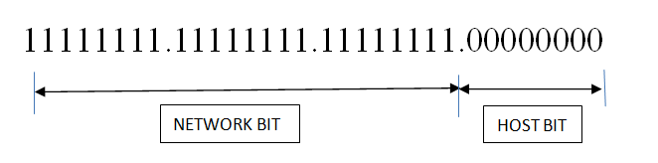
SUBNETTING Example FLSM
Step 1: Calculate the required subnet bit.
We are given a Class C IP address
default subnet mask for Class C is 255.255.255.0

Slide 40

SUBNETTING Example FLSM
Step 1: Calculate the required subnet bit.
Required subnetworks = 4
Here, we need to configure 4 subnets for this we need to borrow 2 bits and making the MSB of host bit of subnet mask to 1 and the value we will get
Step 2 Converted Subnet mask
11111111 . 11111111 . 11111111 . 11000000
255.255.255.192

Slide 42

SUBNETTING Example FLSM
Step 3: We will find the range in this step.
Formula
Range: (Maximum Subnet Mask – Converted Subnet Mask)
Maximum Subnet Mask is always 255.255.255.255 for every case.

Slide 44
SUBNETTING Example FLSM
Step 4: Now we will divide the whole network with the help of the range.
First Network Block: 198.168.10.0 – 198.168.10.63
For this block Network ID will be 198.168.10.0
and Broadcast address will be 198.168.10.63
Second Network Block:198.168.10.64 – 198.168.10.127
For this block Network ID will be 198.168.10.64
and Broadcast address will be 198.168.10.127

Slide 46
SUBNETTING Example FLSM
Step 4: Now we will divide the whole network with the help of the range.
Third Network Block: 198.168.10.128 – 198.168.10.191
For this block Network ID will be 198.168.10.128
and Broadcast address will be 198.168.10.191
Fourth Network Block:198.168.10.192 – 198.168.10.255
For this block Network ID will be 198.168.10.192 and Broadcast address will be 198.168.10.255

Slide 47
SUBNETTING Example VLSM
Difference between FLSM and VLSM
VLSM divide Network into multiple networks according to its need.
Let’s take the same IP address 198.168.10.0
configure the network in such a way that given network able to provide
A network with 20 IP addresses
and a network with 50 IP addresses.

Slide 49
SUBNETTING Example VLSM
Step 1
Arrange requirement in descending order.
A network with 50 IP addresses
A network with 20 IP addresses.
Calculate host bit for first network.
It is given 50 IP addresses is required but 1 IP is required for Network address and another is for Broadcast address.
So total requirement is 50+2=52 IP addresses.

Slide 51
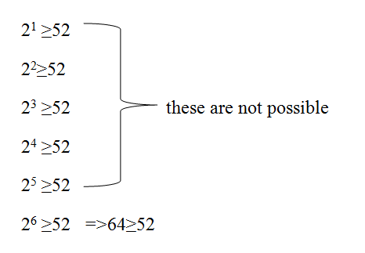
SUBNETTING Example VLSM
Calculate host bit for first network.
52 IP addresses.
From here we can get that 6
Host bit is required,
Host bit = 6

Slide 53
SUBNETTING Example VLSM
Step 2: Find out Network bit with the help of the given formula
Network bit= (32 – Host bit)
In this case Network bit = 32 – 6 =26
Step 3: Calculate updated subnet mask
Now we have the updated subnet mask:
11111111.11111111.11111111.11000000
255.255.255.192

Slide 55

SUBNETTING Example VLSM
Step 3: Range = Maximum Subnet Mask – Updated Subnet Mask
Then we will get the final Range
Network Block for the 50 IP addresses is
198.168.10.0
to
198.168.10.63

Slide 57
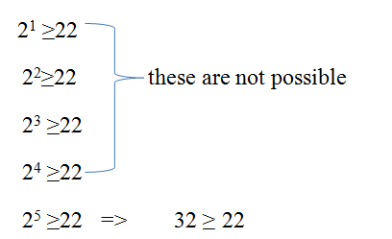
SUBNETTING Example VLSM
Again, for 20 IP addresses we have to follow same 3 steps.
Total IP required = 20+2=22
Step 1:
Required Host Bit = 5

Slide 59
SUBNETTING Example VLSM
Step 2: Required Network Bits = 32 – 5= 27
Updated mask
11111111 . 11111111 . 11111111 . 11100000
255 . 255 . 255 . 224

Slide 60
SUBNETTING Example VLSM
Step 3
Range = Maximum Subnet Mask – Updated Subnet Mask
255 . 255 . 255 . 255
- 255 . 255 . 255 . 224
Range 0 . 0 . 0 . 31
Network Block for 22 IP addresses is
from 198.168.10.64
to 198.168.10.95

Slide 61
SUPERNETTING or Aggregation
In supernetting, an organization can combine several class C blocks to create a larger range of addresses. In other words, several networks are combined to create a super­ network or a supernet.
An organization can apply for a set of class C blocks instead of just one Class B or A.
Notes:
The time came when most of the class A and class B addresses were depleted; however, there was still a huge demand for midsize blocks. The size of a class C block with a maximum number of 256 addresses did not satisfy the needs of most organizations.
Even a midsize organization needed more addresses. One solution was supernetting.

Slide 62
SUPERNETTING or Aggregation
For example, an organization that needs 1000 addresses can be granted four contiguous class C blocks. The organization can then use these addresses to create one supernetwork.
Supernetting decreases the number of Is in the mask.
For example, if an organization is given four class C addresses, the mask changes from /24 to /22.
Classless addressing eliminated the need for subnetting and supernetting.
Notes:
The time came when most of the class A and class B addresses were depleted; however, there was still a huge demand for midsize blocks. The size of a class C block with a maximum number of 256 addresses did not satisfy the needs of most organizations.
Even a midsize organization needed more addresses. One solution was supernetting.

Slide 63
SUPERNETTING or Aggregation
For example, an organization that needs 1000 addresses can be granted four contiguous class C blocks. The organization can then use these addresses to create one supernetwork.
Supernetting decreases the number of Is in the mask.
For example, if an organization is given four class C addresses, the mask changes from /24 to /22.
Classless addressing eliminated the need for subnetting and supernetting.
Notes:
The time came when most of the class A and class B addresses were depleted; however, there was still a huge demand for midsize blocks. The size of a class C block with a maximum number of 256 addresses did not satisfy the needs of most organizations.
Even a midsize organization needed more addresses. One solution was supernetting.

Slide 64
SUPERNETTING or Aggregation
Conditions :
Networks should be contagious
Should be of same size and of 2^{n}.
First network should be divisible total size of the networks.
Example Four class C networks as below:
200.1.0.0
200.1.1.0
200.1.2.0
200.1.3.0
Size of networks
4 Networks X 2⁸
= 2² X 2⁸ = 2¹⁰
First address: 200.1.0.0
11001000.00000001.00000000.00000000
Notes:
The time came when most of the class A and class B addresses were depleted; however, there was still a huge demand for midsize blocks. The size of a class C block with a maximum number of 256 addresses did not satisfy the needs of most organizations.
Even a midsize organization needed more addresses. One solution was supernetting.

Slide 65
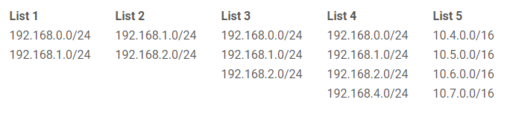
SUPERNETTING or Aggregation
Examples Check Rule1 contagious :
Check contagious by adding 1 to IPs
The networks in List 1 are contiguous. Qualifies for next round.
The networks in List 2 are contiguous. Qualifies for next round.
The networks in List 3 are contiguous. Qualifies for next round.
The networks in List 4 are not contiguous. Does not qualify for next round.
The networks in List 5 are contiguous. Qualifies for next round.
Notes:
The time came when most of the class A and class B addresses were depleted; however, there was still a huge demand for midsize blocks. The size of a class C block with a maximum number of 256 addresses did not satisfy the needs of most organizations.
Even a midsize organization needed more addresses. One solution was supernetting.

Slide 66
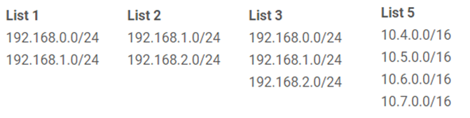
SUPERNETTING or Aggregation
Examples Rule #2: Number of networks order of 2:
Check Number of networks order of 2:
There are 2 networks to be aggregated in List 1 which is an order of 2. Qualifies for next round.
There are 2 networks to be aggregated in List 2 which is an order of 2. Qualifies for next round.
There are 3 networks to be aggregated in List 3 which is not an order of 2. Does not qualify for next round.
There are 4 networks to be aggregated in List 5 which is an order of 2. Qualifies for next round.
Notes:
The time came when most of the class A and class B addresses were depleted; however, there was still a huge demand for midsize blocks. The size of a class C block with a maximum number of 256 addresses did not satisfy the needs of most organizations.
Even a midsize organization needed more addresses. One solution was supernetting.

Slide 67
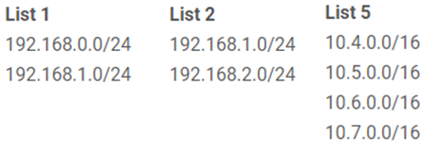
SUPERNETTING or Aggregation
Examples Rule #3: Value of non-common octet in first IP block is zero or a multiple of the number of networks to be aggregated
Rule #3: Value of non-common octet in first IP block is zero or a multiple of the number of networks to be aggregated:
The first non-common octet in List 1 is the 3rd octet i.e. 0 vs. 1. The first (lowest) IP address block is 192.168.0.0/24. The decimal value of the 3rd octet in this address block is 0. Qualifies to be aggregated.
The first non-common octet in List 2 is the 3rd octet i.e. 1 vs. 2. The first (lowest) IP address block is 192.168.1.0/24. The decimal value of the 3rd octet in this address block is 1. This value is not zero or a multiple of the number of networks to aggregated (2). Does not qualify to be aggregated.
The first non-common octet in List 5 is the 2nd octet i.e. 4 vs. 5 vs. 6 vs. 7. The first (lowest) IP address block is 10.4.0.0/16. The decimal value of the 2nd octet in this address block is 4. This value is a multiple of the number of networks to aggregated (4). Qualifies to be aggregated.
Notes:
The time came when most of the class A and class B addresses were depleted; however, there was still a huge demand for midsize blocks. The size of a class C block with a maximum number of 256 addresses did not satisfy the needs of most organizations.
Even a midsize organization needed more addresses. One solution was supernetting.

Slide 68
How-To: Supernetting
Notes:
USA to Indial letter example

Slide 69
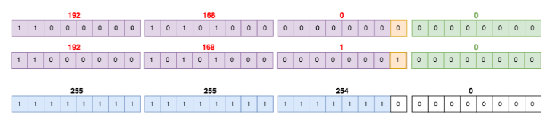
How-To: Supernetting
Example, 192.168.0.0/24 and 192.168.1.0/24
These two networks are the same all the way to the 23rd block .
The 24th block is where the difference is.
Therefore, the subnet mask of the new supernet will be 1 all the way to the 23rd block and then 0 from there:
Finally, the supernet will be the first IP block is 192.168.0.0 with the new subnet mask
192.168.0.0 255.255.254.0 or 192.168.0.0/23.
Notes:
These two networks are the same all the way to the 23rd block (counting from the left side starting at 1). The 24th block is where the difference is (highlighted in orange). Therefore, the subnet mask of the new supernet will be 1 all the way to the 23rd block and then 0 from there:

Slide 70
How-To: Supernetting
Notes:
These two networks are the same all the way to the 23rd block (counting from the left side starting at 1). The 24th block is where the difference is (highlighted in orange). Therefore, the subnet mask of the new supernet will be 1 all the way to the 23rd block and then 0 from there:

Slide 71
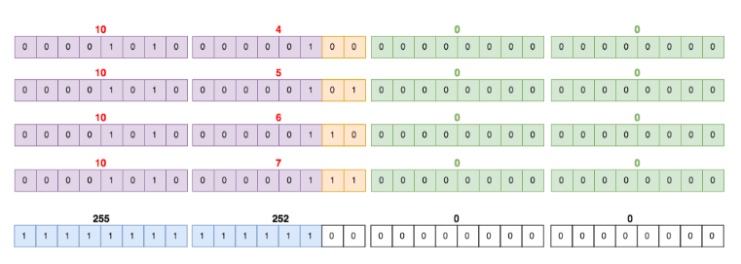
How-To: Supernetting
Example:
10.4.0.0/16, 10.5.0.0/16, 10.6.0.0/16, 10.7.0.0/16.
These networks are the same up to the 14th bit. Therefore, the supernet is 10.4.0.0 255.252.0.0 or 10.4.0.0/14:
Notes:
These two networks are the same all the way to the 23rd block (counting from the left side starting at 1). The 24th block is where the difference is (highlighted in orange). Therefore, the subnet mask of the new supernet will be 1 all the way to the 23rd block and then 0 from there:

Slide 72
Note:
The idea of subnetting and supernetting of classful addresses is almost obsolete.
TCP/IP Protocol Suite

Slide 73
CIDR - Classless Interdomain Routing
In 1993, the size of the routing tables started to outgrow the capacity of routers
Consequence: The Class-based assignment of IP addresses had to be abandoned
Goals:
Restructure IP address assignments to increase efficiency
Hierarchical routing aggregation to minimize route table entries
CIDR
Classless Interdomain routing, abandons the notion of classes:
Key Concept: The length of the network id (prefix) in the IP addresses is kept arbitrary
Consequence: Routers advertise the IP address and the length of the prefix
Notes:
In 1993, the size of the routing tables started to outgrow the capacity of routers
Consequence: The Class-based assignment of IP addresses had to be abandoned

Slide 74
CIDR - Example
CIDR notation of a network address:
192.0.2.0/18
"18" says that the first 18 bits are the network part of the address and 14 bits are available for specific host addresses.
The network part is called the prefix
    Assume that a site requires a network address with 1000 addresses
    With CIDR, the network is assigned a continuous block of 1024 addresses with a 22-bit long prefix
Notes:
In 1993, the size of the routing tables started to outgrow the capacity of routers
Consequence: The Class-based assignment of IP addresses had to be abandoned

Slide 75
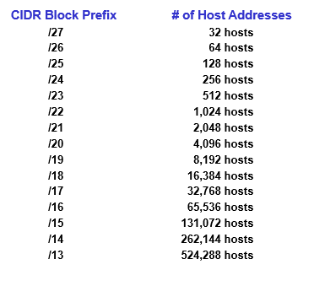
CIDR and Routing Information
CIDR - Example
Notes:
In 1993, the size of the routing tables started to outgrow the capacity of routers
Consequence: The Class-based assignment of IP addresses had to be abandoned

Slide 76
CIDR - Routing Information
Backbone sends everything which matches the prefixes 206.0.64.0/18, 204.188.0.0/15, 209.88.232.0/21 to ISP X.
ISP X does not know about Organizations z1, z2.
Company X :
206.0.68.0/22
ISP X owns:
ISP X sends everything which matches the prefix: 206.0.68.0/22 to Company X,
209.88.237.0/24 to ISP y
206.0.64.0/18
204.188.0.0/15
209.88.232.0/21
ISP y sends everything which matches the prefix:
209.88.237.192/26 to Organizations z1
209.88.237.0/26 to Organizations z2
Internet Backbone
ISP y :
209.88.237.0/24
Backbone routers do not know anything about Company X, ISP Y, or Organizations z1, z2.
Organization z1 :
209.88.237.192/26
Organization z2 :
209.88.237.0/26
Notes:
In 1993, the size of the routing tables started to outgrow the capacity of routers
Consequence: The Class-based assignment of IP addresses had to be abandoned

Slide 77
CIDR - Example
A router receives a packet with the destination address
131.24.67.32/20
Show how the router finds the network address of the packet.
Step 1 : First find Default mask , for / 20 so
Default mask DM
11111111.1111111.11110000.00000000
255.255.240.0

Slide 78
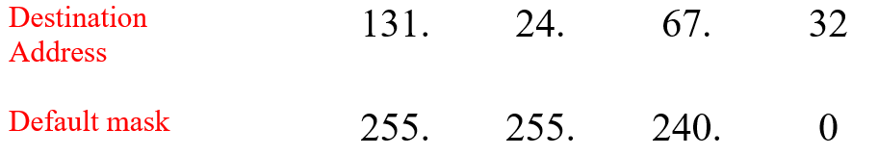
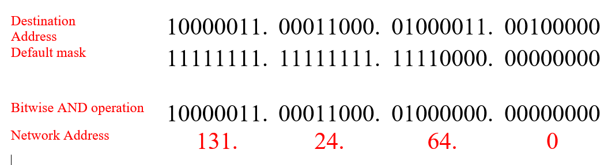
CIDR - Example
Step 2: Bitwise AND operation between IP and Default Mask, to find network address

Slide 79
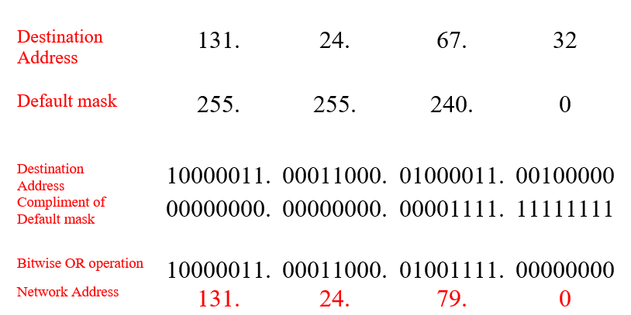
CIDR - Example
Step 3: Bitwise OR operation between IP and compliment of Default Mask, to find
Direct Broadcast address
Limited Broadcast address is 255.255.255.255

Slide 80
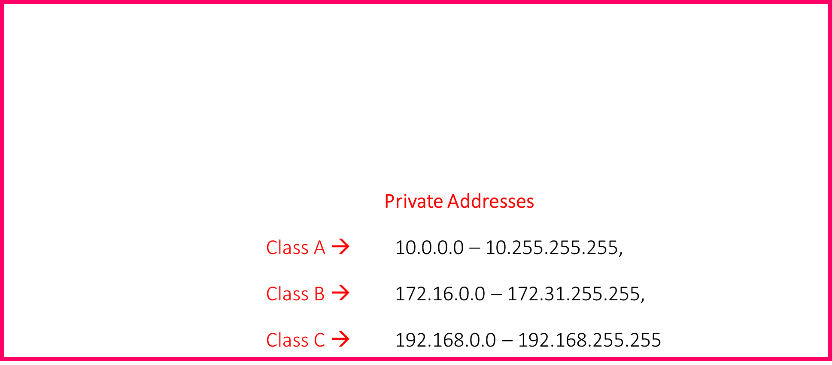
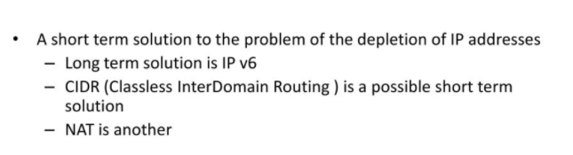
NAT : Network Address Translation
Notes:
Private Addresses
10.0.0.0 – 10.255.255.255,
172.16.0.0 – 172.31.255.255,
192.168.0.0 – 192.168.255.255

Slide 81
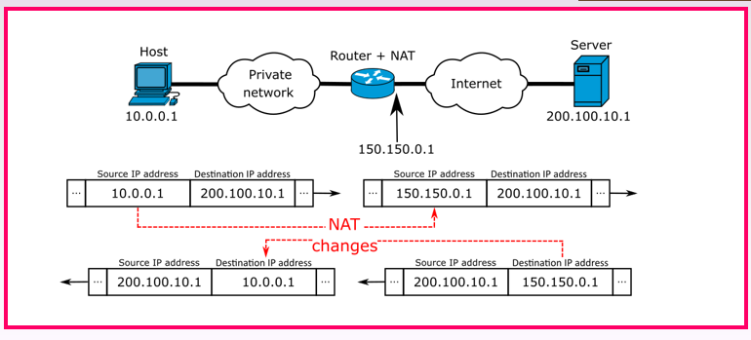
NAT : Network Address Translation
Notes:
Private Addresses
10.0.0.0 – 10.255.255.255,
172.16.0.0 – 172.31.255.255,
192.168.0.0 – 192.168.255.255

Slide 82
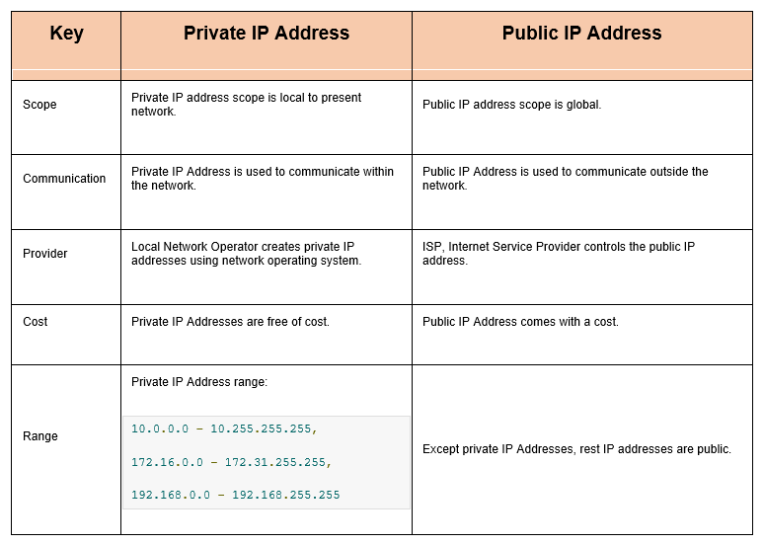
NAT : Network Address Translation
Notes:
Private Addresses
10.0.0.0 – 10.255.255.255,
172.16.0.0 – 172.31.255.255,
192.168.0.0 – 192.168.255.255

Slide 83
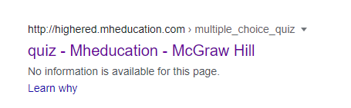

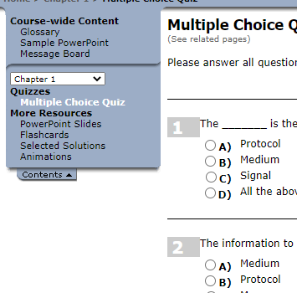
Links for mcq
Link for books mcq
http://highered.mheducation.com/sites/0072967757/student_view0/chapter1/multiple_choice_quiz.html
From the above link chose the chapter number and click on Multiple Choice Quiz.
Notes:
In 1993, the size of the routing tables started to outgrow the capacity of routers
Consequence: The Class-based assignment of IP addresses had to be abandoned

Slide 84


See you in next class

